Slide 1

Spring Boot
Database Programming

Slide 2
Spring JDBC with Spring Boot
We need data source
We need to build JdbcTemplate using DS
We will be using methods defined in JdbcTemplate and providing our SQL queries
Spring Boot requires very minimal configuration for this
No need to explicitly define dependencies in Beans.xml
We will be using spring-boot-starter-jdbc

Slide 3
Spring JDBC with Spring Boot
We need data source
We need to build JdbcTemplate using DS
We will be using methods defined in JdbcTemplate and providing our SQL queries
Spring Boot requires very minimal configuration for this
No need to explicitly define dependencies in Beans.xml
We will be using spring-boot-starter-jdbc

Slide 4
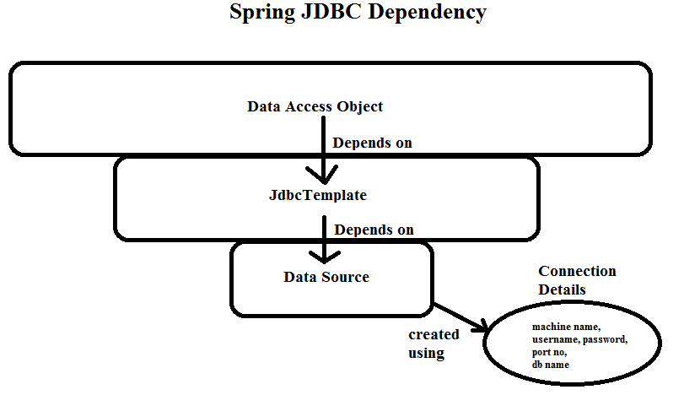
Spring JDBC with Spring Boot

Slide 5
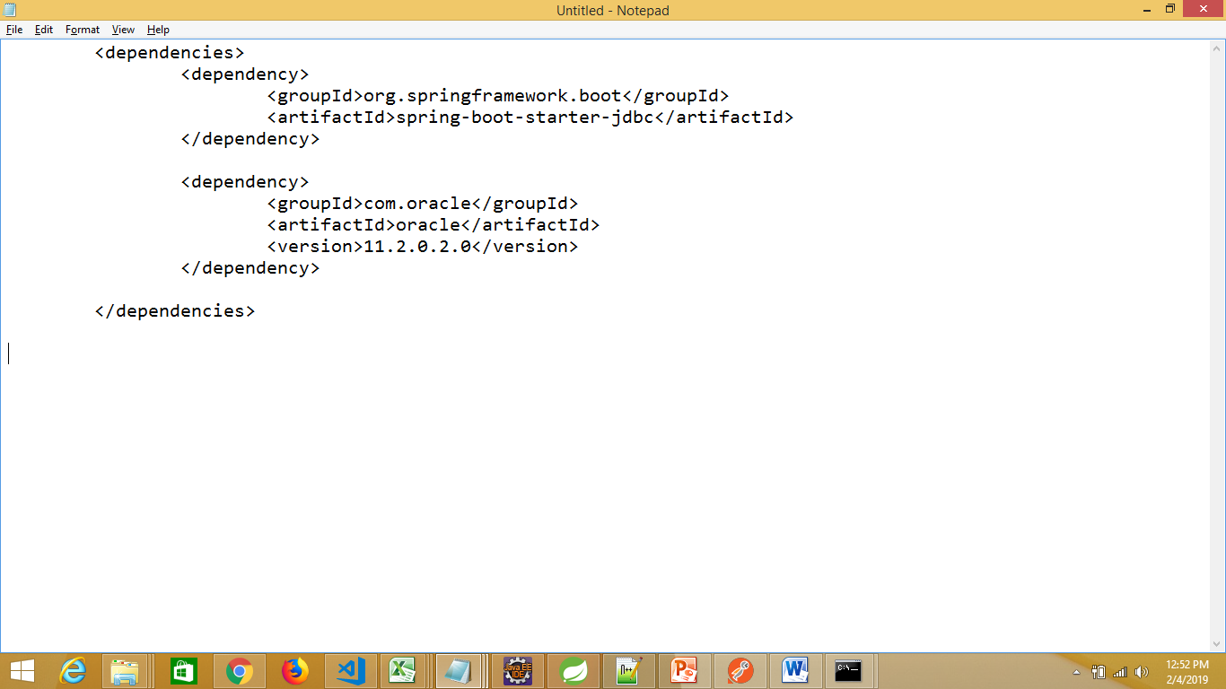
Spring JDBC with Spring Boot
Let’s create a console based application for a change
So, bootstrap Spring application using File…new…Spring Starter Project
Your pom.xml should depend on:

Slide 6
Spring JDBC with Spring Boot
You would get an error in pom.xml saying oracle
Missing artifact com.oracle:oracle:jar:11.2.0.2.0
This means, that this particular .jar file is not found in public maven repository due to licensing issue
You must download this file (ojdbc6.jar) from oracle website – for version 11.2.0.2.0
https://www.oracle.com/technetwork/apps-tech/jdbc-112010-090769.html

Slide 7
Spring JDBC with Spring Boot
Go to the folder where you have downloaded “ojdbc6.jar”
Now, install this .jar file into local maven repository by invoking the following command:
mvn install:install-file -Dfile=ojdbc6.jar -DgroupId=com.oracle -DartifactId=oracle -Dversion=11.2.0.2.0 -Dpackaging=jar -DgeneratePom=true
You should get “BUILD SUCCESS” message
This last parameter for generating a POM will save you from pom.xml warnings

Slide 8
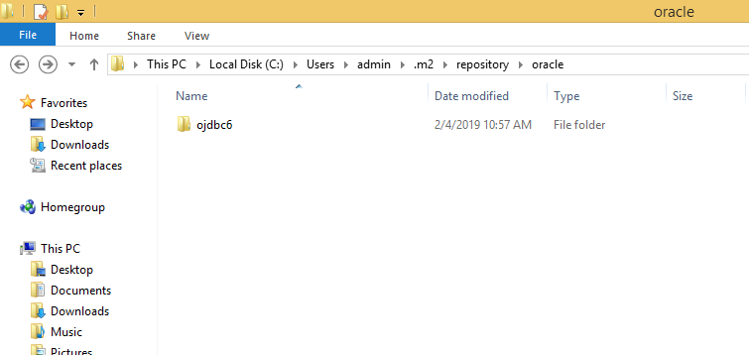
Spring JDBC with Spring Boot
You should see an entry in your local maven repository:

Slide 9
Spring JDBC with Spring Boot
Provide all connection details of ORACLE DB in application.properties
application.properties (resource folder)
server.port=8091
#oracle db settings
spring.datasource.url=jdbc:oracle:thin:@localhost:1521:xe
spring.datasource.username=<<your-user-name>>
spring.datasource.password=<<your-password>>
spring.datasource.driver-class-name=oracle.jdbc.OracleDriver

Slide 10
Spring JDBC with Spring Boot
Create the database table “employee” in ORACLE DB
create table employee(firstname varchar2(20) primary key,
lastname varchar2(20),
phonenumber number(10),
emailid varchar2(20));
Make sure the table gets created
If you select from this table, you would see zero records

Slide 11
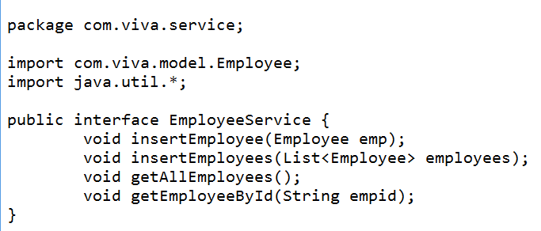
Spring JDBC with Spring Boot
Let’s create EmployeeService interface

Slide 12
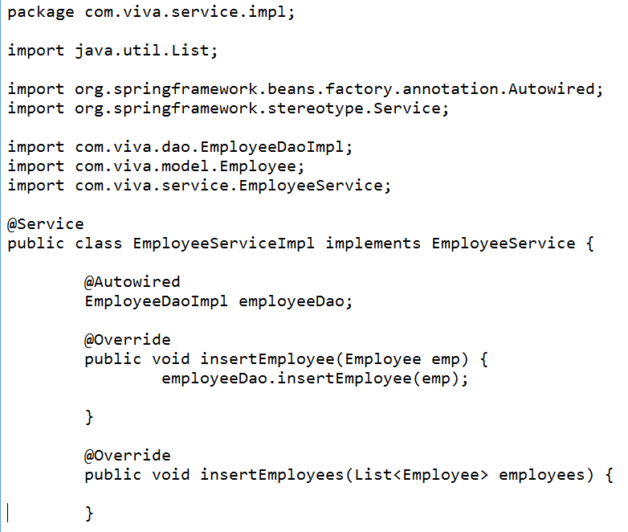
Spring JDBC with Spring Boot
Let’s implement EmployeeService interface

Slide 13
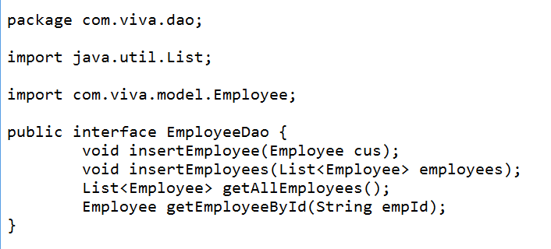
Spring JDBC with Spring Boot
Let’s create EmployeeDao interface

Slide 14
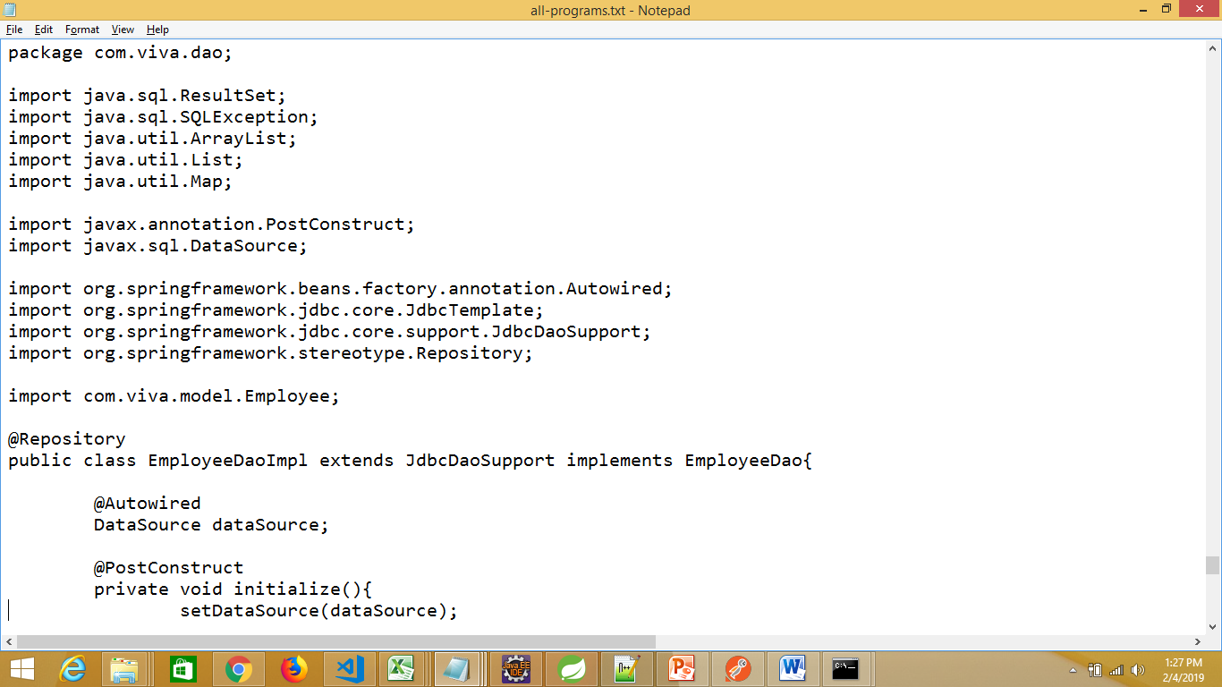
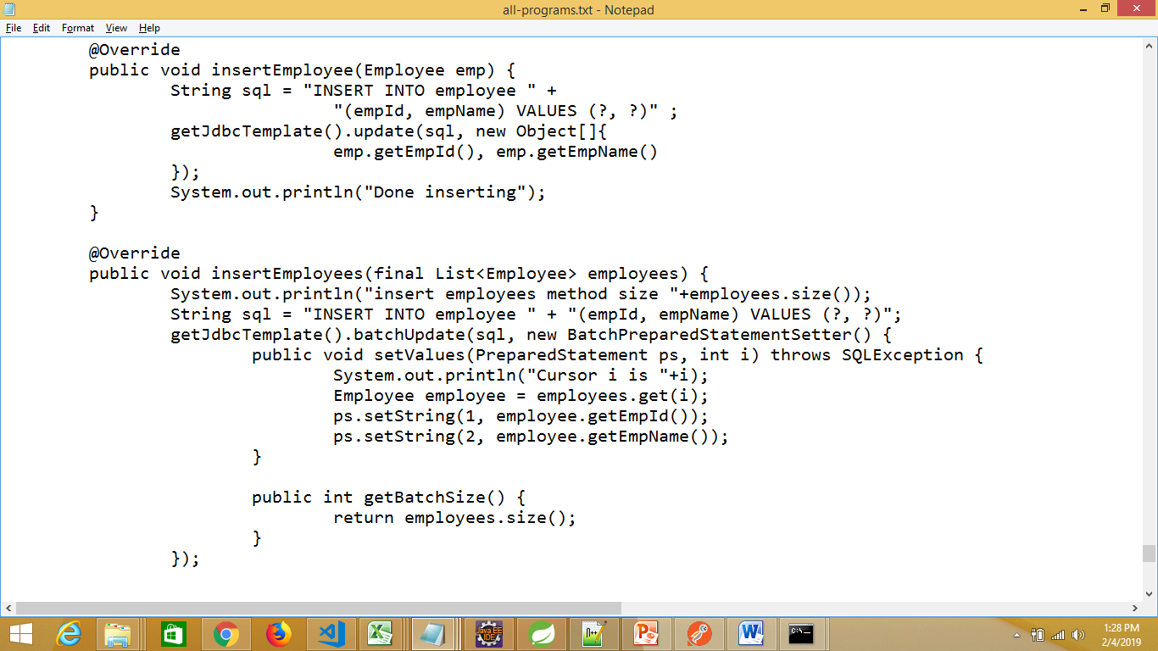
Spring JDBC with Spring Boot
Implement EmployeeDao interface

Slide 15
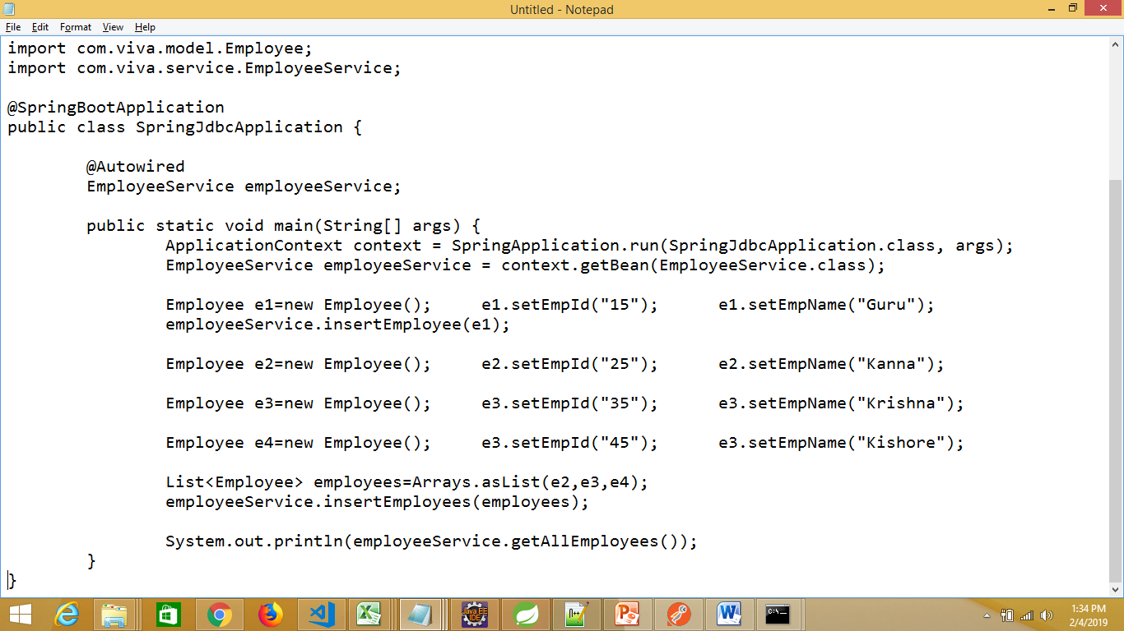
Spring JDBC with Spring Boot
Create and run the application as stand-alone

Slide 16
Spring Boot Database Spring Data JPA

Slide 17
Spring Data JPA
JPA - Java Persistence API
Specification for ORM
SQL Databases are called Relational Databases(keys: primary & foreign keys)
JDBC
Class <-> Table (you need to do the mapping yourself)
ORM maps Classes to Tables

Slide 18
Spring Data JPA
Spring Data JPA is a separate project
It lets you to work with ORM tools even easier
You don’t need to write any XML configuration files
This is going to be super easy
Connecting to embedded Databases
Connecting to external Databases

Slide 19
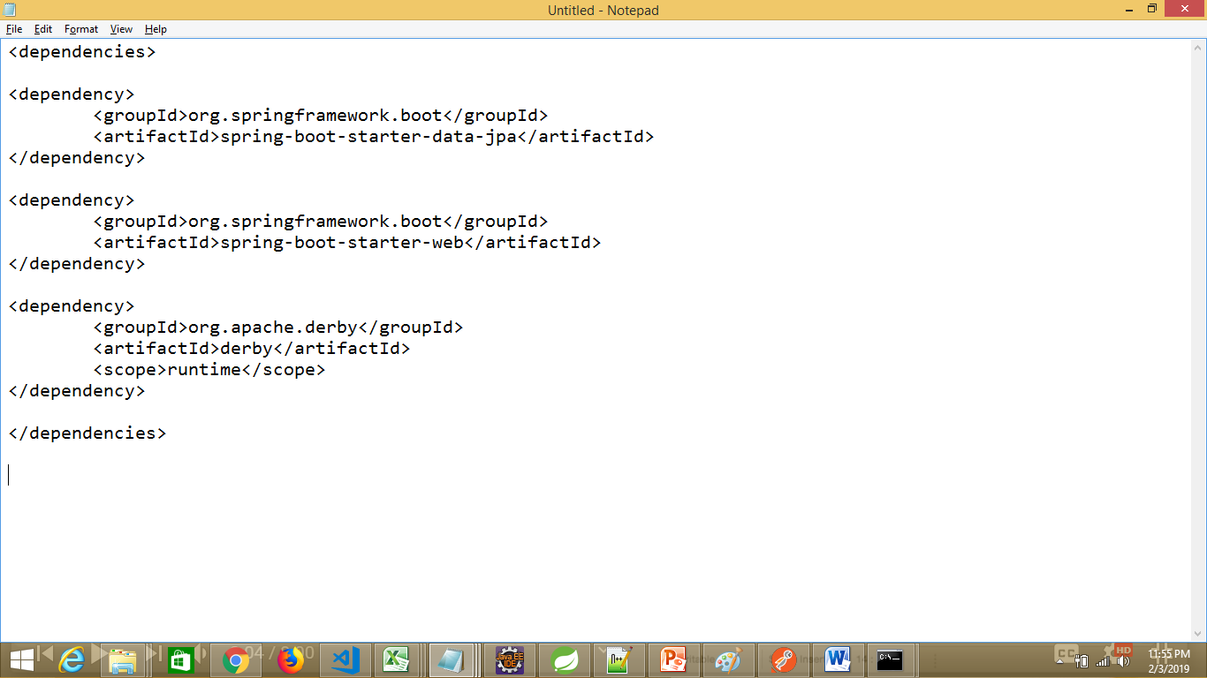
Spring Data JPA Connecting to embedded Databases (Apache Derby)

Slide 20
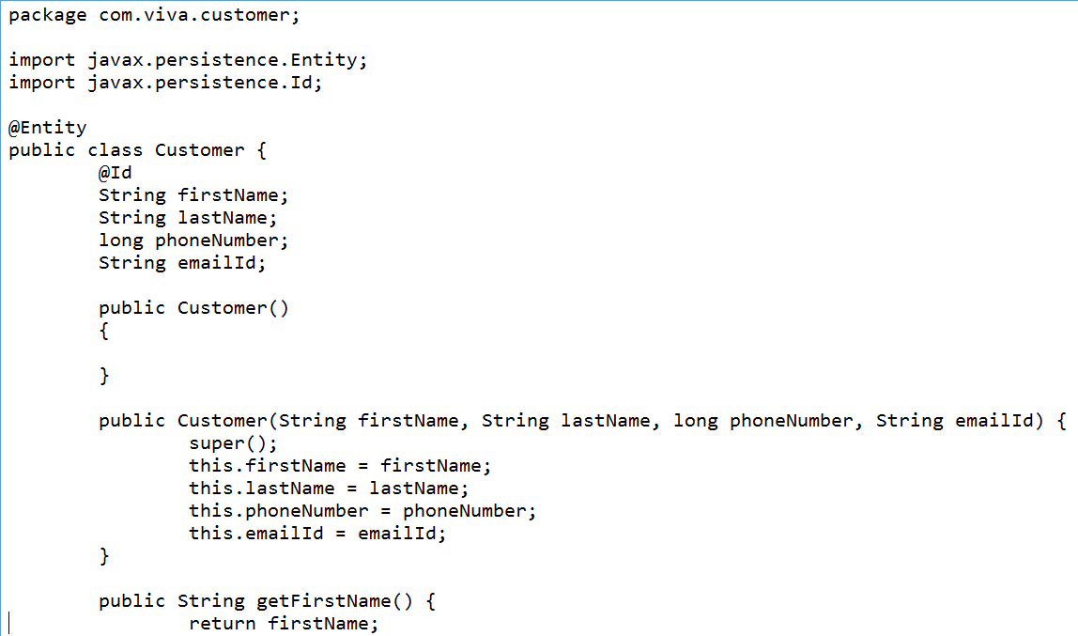
Spring Data JPA Marking your POJO as @Entity & @Id

Slide 21
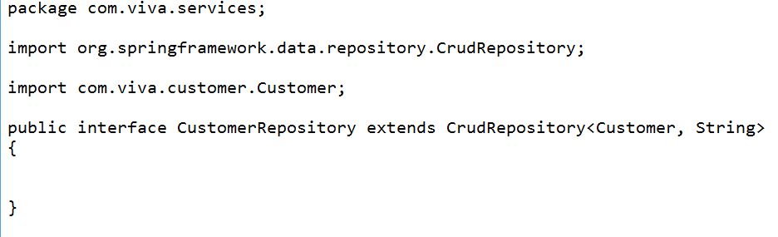
Spring Data JPA Creating Data Service Class / Creating a Spring Data JPA Repository

Slide 22
Spring Data JPA Connecting to external Database (ORACLE)
From pom.xml:
Remove the derby related dependency
Add “oracle db” as dependency
<dependency>
<groupId>com.oracle</groupId>
<artifactId>oracle</artifactId>
<version>11.2.0.2.0</version>
</dependency>

Slide 23
Spring Data JPA Connecting to external Database (ORACLE)
You would get an error in pom.xml saying oracle
Missing artifact com.oracle:oracle:jar:11.2.0.2.0
This means, that this particular .jar file is not found in public maven repository due to licensing issue
You must download this file (ojdbc6.jar) from oracle website – for version 11.2.0.2.0
https://www.oracle.com/technetwork/apps-tech/jdbc-112010-090769.html

Slide 24
Spring Data JPA Connecting to external Database (ORACLE)
Go to the folder where you have downloaded “ojdbc6.jar”
Now, install this .jar file into local maven repository by invoking the following command:
mvn install:install-file -Dfile=ojdbc6.jar -DgroupId=com.oracle -DartifactId=oracle -Dversion=11.2.0.2.0 -Dpackaging=jar -DgeneratePom=true
You should get “BUILD SUCCESS” message
This last parameter for generating a POM will save you from pom.xml warnings

Slide 25
Spring Data JPA Connecting to external Database (ORACLE)
You should see an entry in your local maven repository:

Slide 26
Spring Data JPA Connecting to external Database (ORACLE)
Provide all connection details of ORACLE DB in application.properties
application.properties (resource folder)
server.port=8091
#oracle db settings
spring.datasource.url=jdbc:oracle:thin:@localhost:1521:xe
spring.datasource.username=<<your-user-name>>
spring.datasource.password=<<your-password>>
spring.datasource.driver-class-name=oracle.jdbc.OracleDriver

Slide 27
Spring Data JPA Connecting to external Database (ORACLE)
Create the database table “customer” in ORACLE DB
create table customer(FIRST_NAME VARCHAR2(10), LAST_NAME VARCHAR2(10), PHONE_NUMBER NUMBER(10), EMAIL_ID VARCHAR(10))
Make sure the table gets created
If you select from this table, you would see zero records

Slide 28
Spring Data JPA Connecting to external Database (ORACLE)
Good news is:
No change required in entity class (Customer)
No change is required in controller class
No change is required in service class
No change is required in repository class
Now, restart the application
With postman client:
Create some resources (records)
View the resources
Update resources
Delete some resources

Slide 29
Thank You

